Slide 1
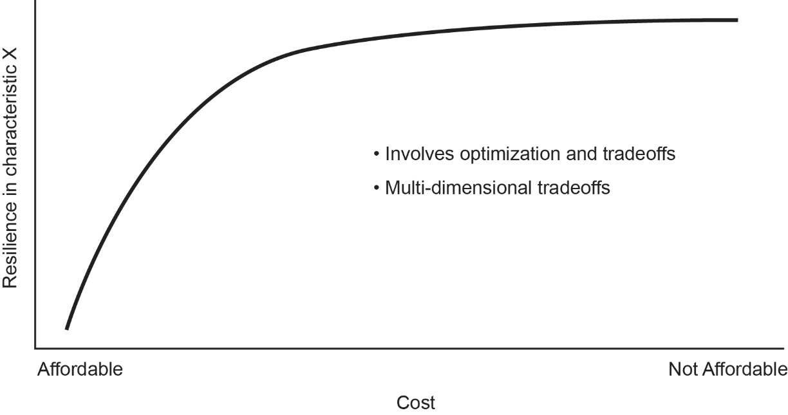
Small Increase in Resilience
Beyond point of diminishing returns
Resilience in Technical Attribute X
Large Increase
in Resilience
Small Cost Increase
Large Cost Increase
Cost
Modified from Source: Marilee J. Wheaton “Resiliency and Affordability Attributes in a System Integration Tradespace”
AIAA Space 2015 Pasadena, CA

